Slide 1

JS Calendar
Alvaro Merino - Ernest Duocastella - Brahim Benalia - Kendra Lambillon - Jordi Arnau

Slide 2
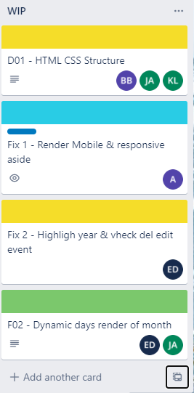
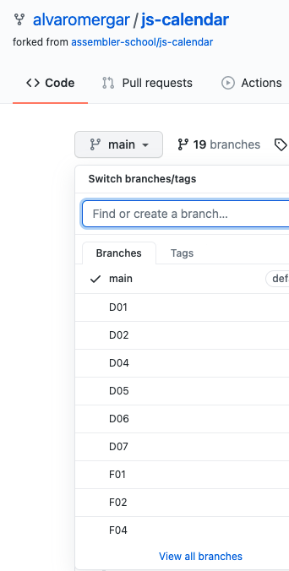
Organization Tasks
Trello
Extras
Tarea Disponible
WIP
Ready to Merge
Finish
Git
24 branches
171 commits

Slide 3

Role Organization
HTML and CSS
Peer programming : groups of 2 - 3 people
Taking into account the level of knowledge of each one
Taking turns writing code
JavaScript
Peer programming : groups of 2 people
Individual for a specific task
The main objective is to learn
Meetings
2 - 3 each day

Slide 4
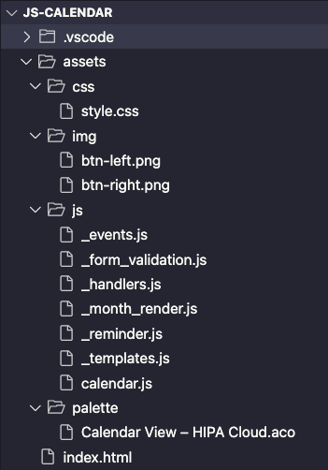
Code architecture
HTML - one file
Header
Mobile Nav
Month Template
Modal Template
Alert Event Template
JS - Multiple files
General Script - calendar.js
Specific Scripts for each feature mentioned with _
CSS - one file
Color Palette
General Styles
Modal New Event
Nav Styles
Nav Mobile Styles
Calendar Styles
Modal Styles
Event Styles
Alert Styles
Media queries (medium screen, large screen, animations)

Slide 5
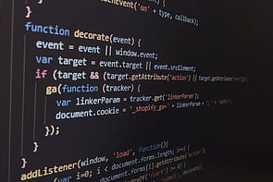
What we have learned
HTML and CSS
Grid
DOM
BEM
Media query
Animations
JavaScript
DOM and events
Timing events and dates
localStorage
Validate forms
Keyboard keys events
Keyframes
JSON

Slide 6
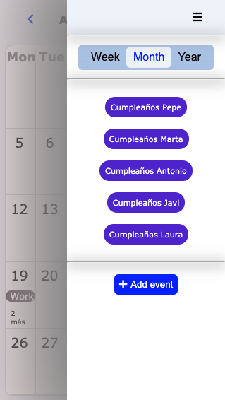
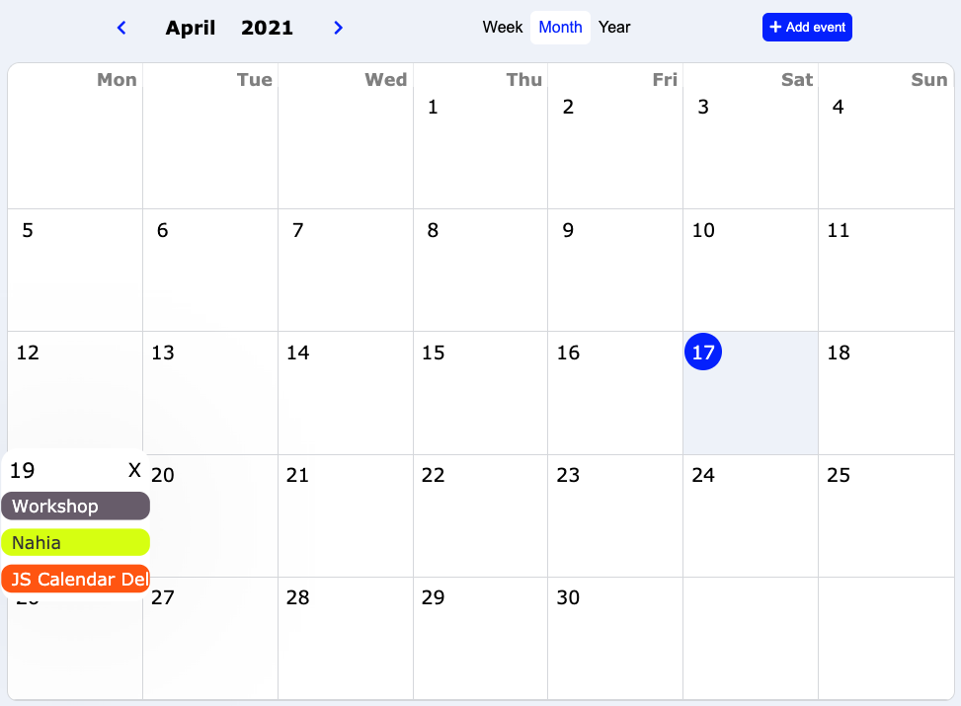
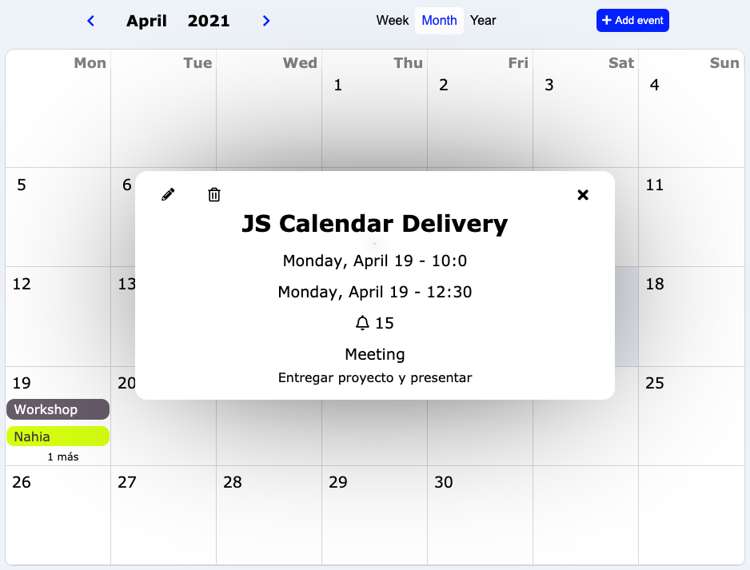
Calendar Design

Slide 7

DEMO & QUESTIONS

